Slide 1
E-commerce site premium Nike Shoes Site
A Web Development Mini Project By: Nikhil Verma(20CS3041)

Slide 2
About
It is a simple E-commerce site of some premium sub-brands of Nike.
It provides you the selectin freedom like other sites but in a more interactive way.
It has its own payment portal gateway.
A simple and user friendly design for the better experience.

Slide 3
features
Exciting options for selecting premium shoes.
Quotes and images gallery for providing you information and raise your excitation level.
Separate feature gallery to provide you additional information about the company.
Useful links in the footer for better connectivity & interaction.

Slide 4
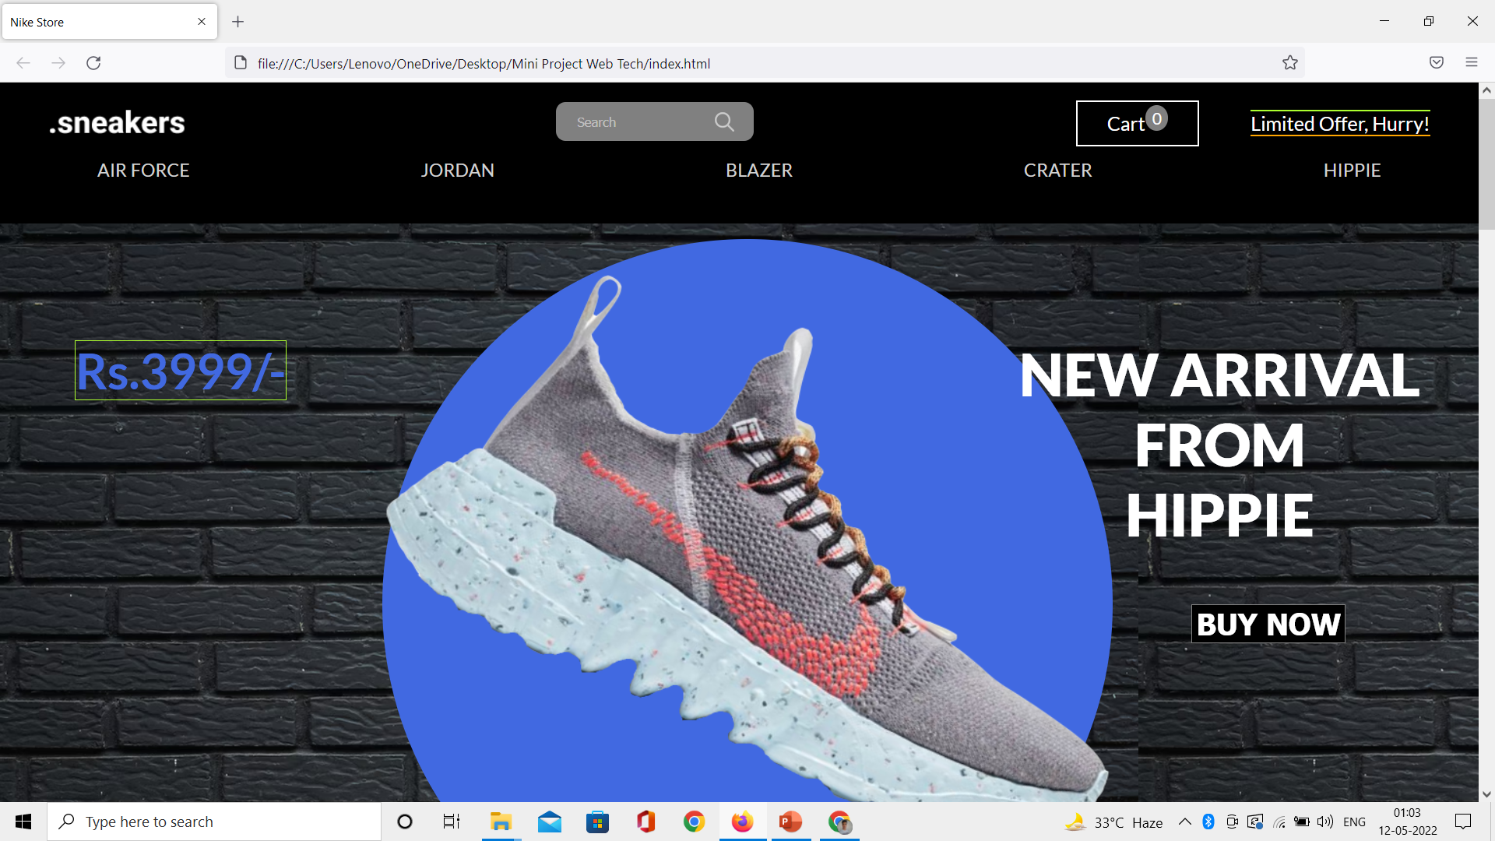
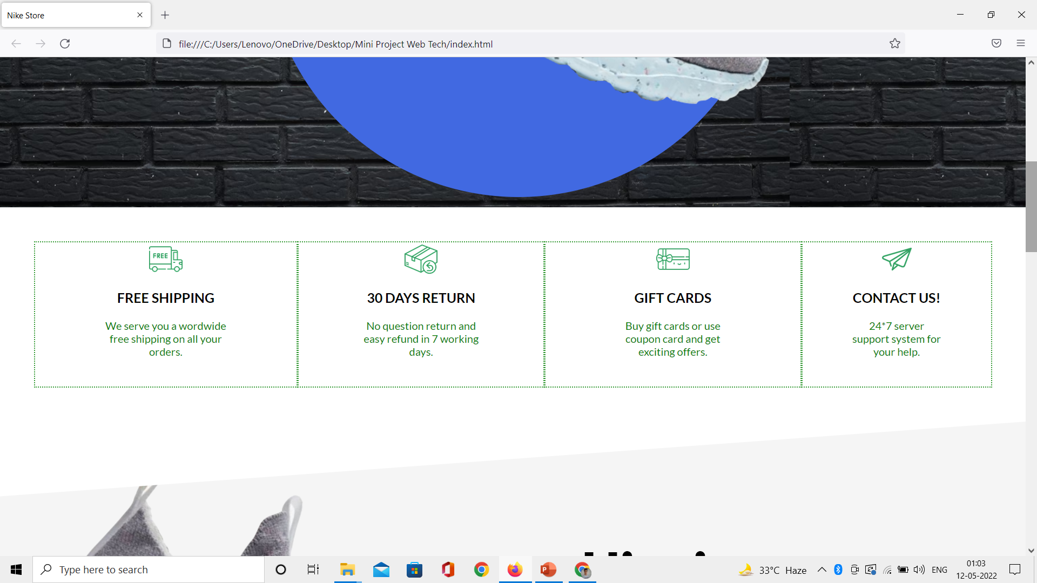
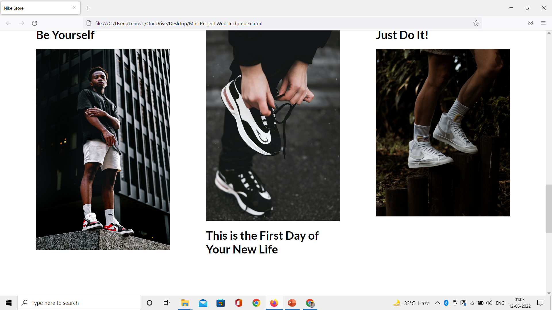
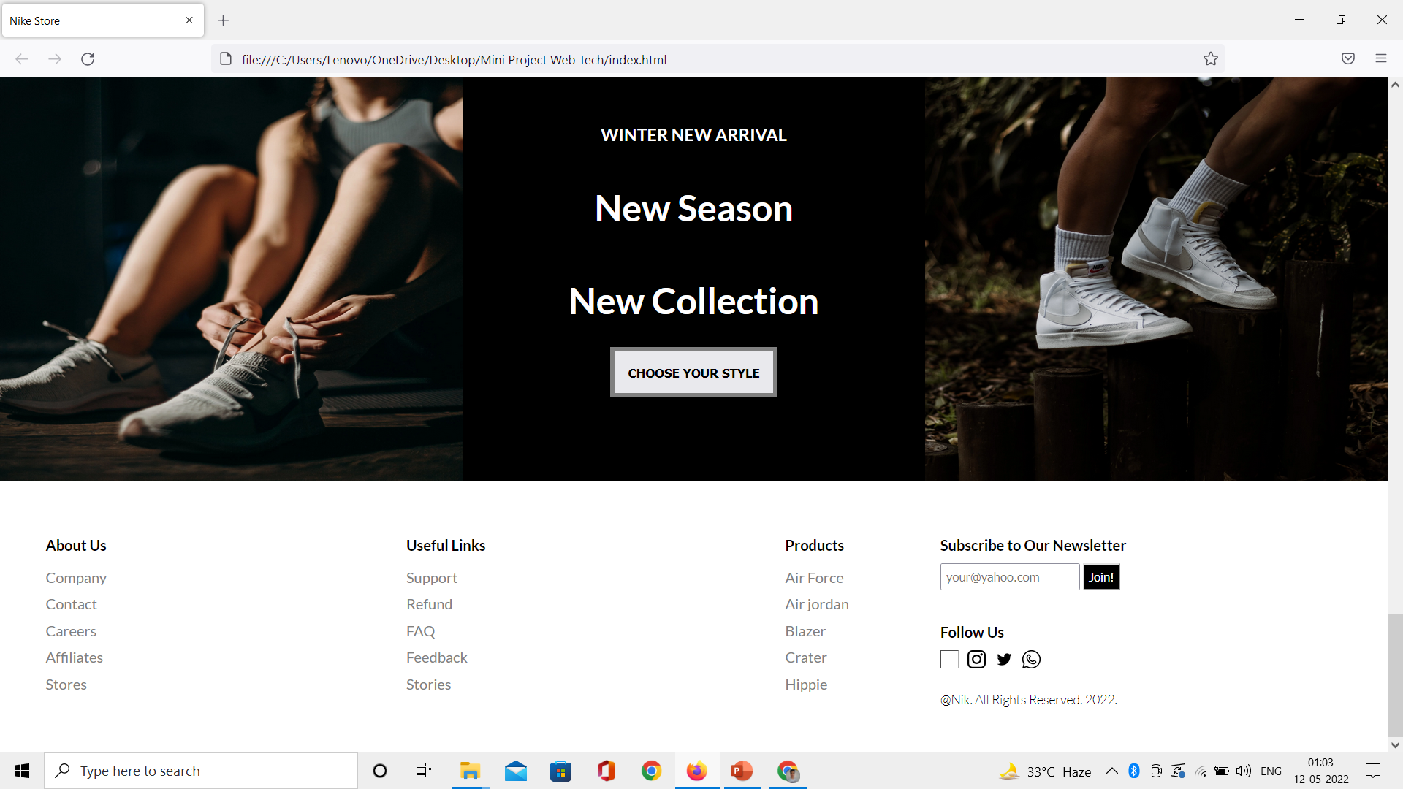

Slide 5
Bonus Features
A home page slider that will directly let you access main product for ease-in payment.
Self payment portal gateway.
A very interactive cart system (under evaluation).
Better animation and box designing.

Slide 6
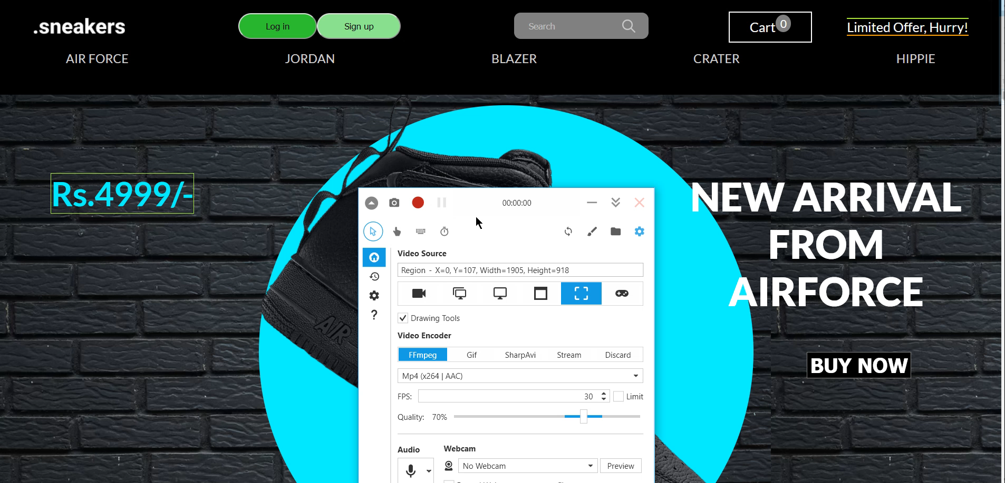

Slide 7
Some developer talk
This site is using a normal HTML and CSS for its designing.
This makes it more RAW for designing and ease-for-evaluation website in future.
For backend and product showcase it uses javascript with array implementation and separate id for each product.
Its every element has its own class and for individual part of site has own division with class for each.

Slide 8
Let’s have a tour

Slide 9


Slide 10
Thank You 😊

